Slide 2
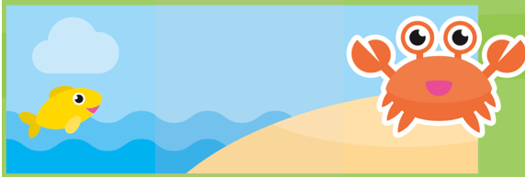
Music attribution: https://www.bensound.com/royalty-free-music
Illustration attribution: Vecteezy.com
Game content was created by Xia Tran 2018

Slide 3








Rules for Moomoo :
What Moomoo wants :
Moomoo is a demanding pet to have..
You must obey his every whim in time or else he will complain and threaten to run away
If you get his demands wrong, he will threaten to run away
If you displease him one too many times (if your score is 0), he will definitely run away
Try to keep him happy, I’m sure he’s worth it!
Moomoo is hungry – Feed him some food to fill his belly
Moomoo is annoyed – Put him in the box for time out
Moomoo is bored – Give him a ball to play with
Moomoo is feeling ill – Give him some medicine to make him better
Moomoo had an accident – You need to clean his turds
Moomoo wants your attention – Give him a pat to make him feel important

